Slide 1
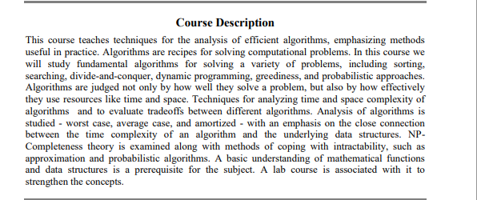

Slide 2
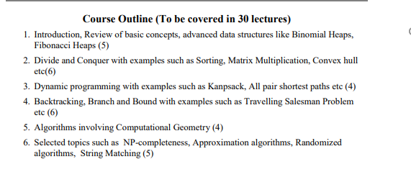

Slide 3
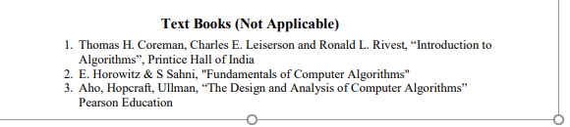

Slide 4
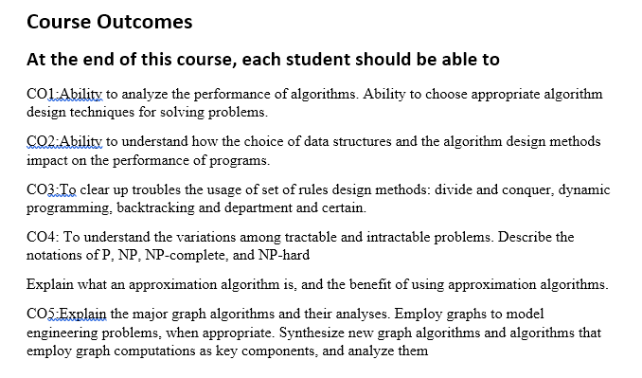

Slide 5
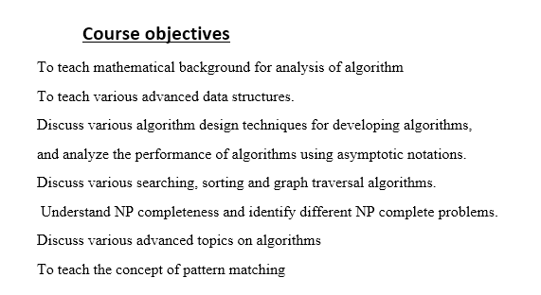

Slide 6
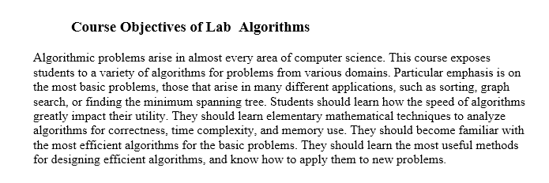

Slide 7
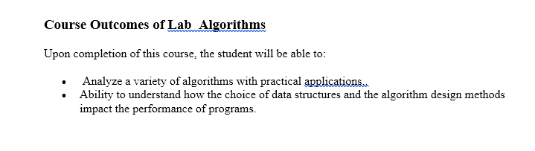

Slide 8
Analysis of algorithms

Slide 9
Text/Reference Books
Introduction to Algorithms
Thomas H. Coreman, Charles E. Leiserson and Ronald L. Rivest
Fundamentals of Computer Algorithms
E. Horowitz & S Sahni
The Design and Analysis of Computer Algorithms
Aho, Hopcraft, Ullman

Slide 10
ALGORITHM
A finite set of instructions which if followed accomplish a particular task.
In addition every algorithm must satisfy following criteria:

Slide 11
Input: zero or more quantities externally supplied
Output: at least one quantity is produced
3. Definiteness: Each instruction must be clear and unambiguous.
4. Finiteness: In all cases algorithm must terminate after finite number of steps.
5. Effectiveness: each instruction must be sufficiently basic.

Slide 12
Two algorithms on two systems
Algorithm A₁ 50 n lg n
Algorithm A₂ 2 n²
A₂
Super computer
10⁸ ins/sec
A₁
P.C
10⁶ ins /sec

Slide 13
For n = 10⁶
Time taken by Super Computer
= 2.(10⁶)²/ 10⁸ = 20,000 sec
Time taken by P .C.
= 50 . 10⁶ lg 10⁶ / 10⁶ = 1,000 sec

Slide 14
Thus by using a fast algorithm , the personal computer gives results
20 times faster than the result given by super computer using a slow algorithm.
Thus a good algorithm is like a sharp knife, it does exactly what it is supposed to do
with a minimum amount of effort.

Slide 15
Complexity
Some questions to answer:
How fast can we solve a problem?
There may be many algorithms for a
given problem. Which algorithm to use?
What are the classical algorithm
design techniques ?
Are there problems inherently difficult
to solve?

Slide 16
How do we express the complexity of algorithm?
Resources : Time and Space
Complexity lower bounds for problems.
Complexity classes P, NP etc.

Slide 17
Pseudocode
Pseudocode is an English language like representation of the code required for an algorithm.
It is partly English, partly structured code.
The English part provides a relaxed syntax that is easy to read.
The code part consists of an extended version of the basic algorithmic constructs-sequence, selection and iteration.

Slide 18
Sequence, selection, loop
A sequence is a series of statements that do not alter the execution path within an algorithm.
Statements such as assign and add are sequence statements.
A call to another algorithm is also considered a sequence statement.
Selection statements evaluate one or more alternatives. Paths are followed based on its result.

Slide 19
The typical selection statement is the two way selection
if (condition) action 1 else action 2.
The part of the loop are identified by indentation.
Loop iterates a block of code. It closely resembles the while loop. It is a pretest loop.

Slide 20
Example
Algorithm deviation
It finds deviations from average.
Pre: nothing
Post: numbers are read and deviation from average printed

Slide 21
i= 0
Loop(all data are read)
1 I = I + 1
2 read numbers into array[i]
3 sum = sum + number
Average = sum / I
Print (average)
J = 0
Loop (j < i)
1 j = j+ 1
2 dev = array[j] – average
3 print (array [ j] . Dev)
Return
End deviation

Slide 22
Analysis vs. Design
Analysis: predict the cost of an algorithm in terms of resources and performance
Design: design algorithms which minimize the cost

Slide 23
Time Complexity
Real Time:
To analyze the real time complexity of a program we need to determine two numbers for each statement in it:
amount of time a single statement will take.
No. of times it is executed.
Product of these two, will be the total time taken by the statement.

Slide 24
First no. depends upon the machine and compiler used , hence the real time complexity is machine dependent.

Slide 25
Machine model: Generic Random Access Machine (RAM)
Executes operations sequentially
Set of primitive operations:
  Arithmetic. Logical, Comparisons, Function calls
Simplifying assumption: all ops cost 1 unit
  Eliminates dependence on the speed of our computer, otherwise impossible to verify and to compare

Slide 26
Frequency count
To make analysis machine independent
it is assumed that every instruction takes the same constant amount of time for execution.
Hence the determination of time complexity of a program is the matter of summing the frequency counts of all the statements.

Slide 27
Linear loop
i=1
Loop(I <= 1000)
  1 application code
  2 I = I + 1
  The body of the loop is repeated 1000 times.
  I = 1
  Loop (I <= n)
    Application code
    I = I + 2
    For this the code time is proportional to n

Slide 28
Logarithm Loops
  Multiply loops Divide loops
  I = 1 1 I = n
  Loop (I < n) 2 loop( i>= 1)
    1 application code 1 application code 2 I=I/2
    2 I = i*2
  F(n) = [log n] F(n) = [log n]

Slide 29
Nested loop- linear logarithmic
1 I = 1
2 loop(I <= n)
  1 j = 1
  2 loop( j < = n)
  1 application code
  2 j = j *2
  3 I = I + 1
  F(n ) = [n log n]

Slide 30
Dependent Quadratic
1 I = 1
2 loop ( I < = n)
1 j = 1
2 loop( j < = i)
1 application code
2 j = j + 1
3 I = I + 1
no of iterations in the body of the inner loop is
1 + 2 + 3 + 4 +… + n I.e. n(n +1)/2
On an average = ( n+1/)2
thus total no of iterations = n (n+1)/2

Slide 31
Quadratic
i=1
Loop (I < = n)
  j = 1
  Loop( j < = n)
  1 application code
  2 j = j+1
  I = i+1
  F(n) = n²

Slide 32
Insertion sort
INSERTION-SORT (A, n) ⊳ A[1 . . n]
for j ← 2 to n
do key ← A[j]
i ← j – 1
while i > 0 and A[i] > key
do A[i+1] ← A[i]
i ← i – 1
A[i+1] ← key
“pseudocode”
1
j
i
n
A:
key
sorted

Slide 33
Insertion Sort
// At start, the singleton sequence A[1] is trivially sorted Freq.
1 for j ← 2 to length[A] n
2 do key ← A[j] n-1
* insert A[j] into sorted array * sequence A[1….j-1]
I ← j-1 n-1
// let tj be the number of times the following
//while-loop is tested for the value j
4 while I> 0 and A[I] > key ∑t_{j}
Do A[I+1] ← A[I] ∑(t_{j}-1)
6 I ← I-1 ∑(t_{j}–1)
7 A[I+1] ← key n-1

Slide 34
T(n) = c₁ n + c₂ (n-1) + c3(n-1)+
c₄ ∑t_{j} + c₅ ∑(t_{j}-1) +
c₆ ∑(t_{j}-1) + c₇ (n-1)

Slide 35
If C_{j} = 1
T(n) = n + (n-1) + (n-1) + Σt_{j} + 2 Σ(t_{j}-1) + (n-1)
= n + 3(n-1) + 3Σt_{j} -2(n-1)
T(n) = 2n + 3 Σ (t_{j} ) for j = 1 to n-1
= O( n² )

Slide 36
Worst Case and best case
Best case: file is already sorted
in this case t_{j} = 1
so total time is a linear function of n
Worst case: if file is in the reverse order
in this case t_{j} = j-1
so total time is a quadratic function of n

Slide 37
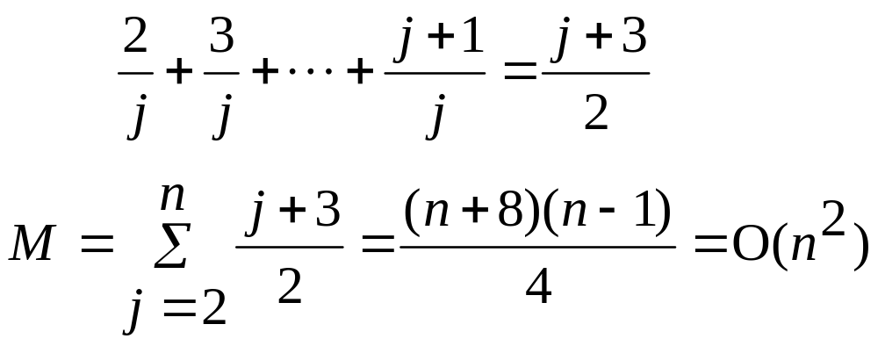
average case:
x_{j} is being inserted into the sorted sequence
x₁ x₂ ... x _{j-1}
the probability that x_{j} is the largest: 1/j
  takes 2 data movements
the probability that x_{j} is the second largest : 1/j
  takes 3 data movements
:
# of movements for inserting x_{j}:
1 4 7 5

Slide 38
Binary search
sorted sequence : (search 9)
1 4 5 7 9 10 12 15
step 1 ↑
step 2 ↑
step 3 ↑
best case: 1 step = O(1)
worst case: (⎣log₂ n⎦+1) steps = O(log n)
average case: O(log n) steps

Slide 39
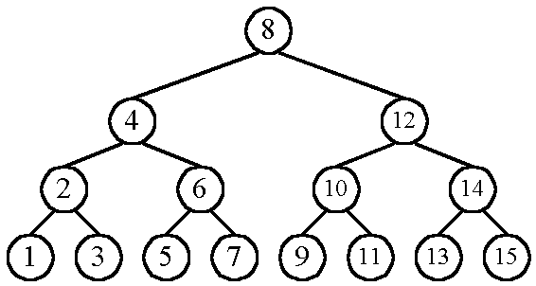
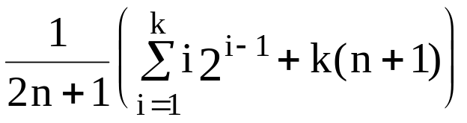
    n cases for successful search
    n+1 cases for unsuccessful search?
    Average # of comparisons done in the binary tree:
    A(n) = , where k = ⎣log n⎦+1

Slide 40
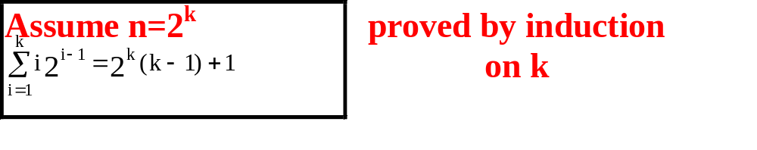
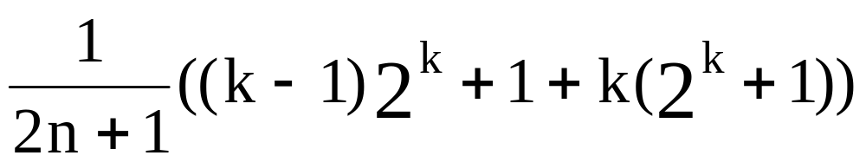
      A(n) =
      ≈ k as n is very large
      = log n
      = O(log n)

Slide 41
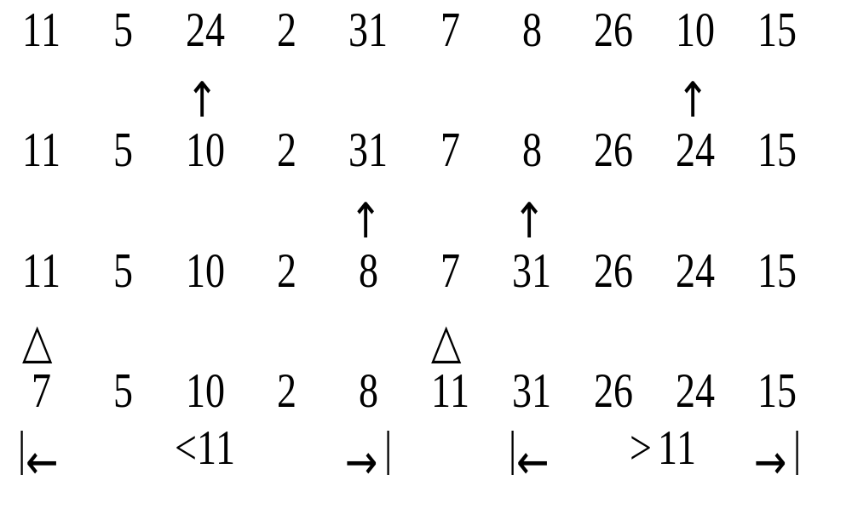
Quick sort
Recursively apply the same procedure.

Slide 42
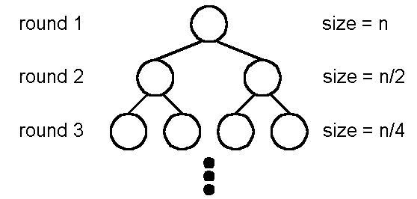
Best case : O(n log n)
  A list is split into two sublists with almost equal size.
log n rounds are needed.
In each round, n comparisons (ignoring the element used to split) are required.

Slide 43
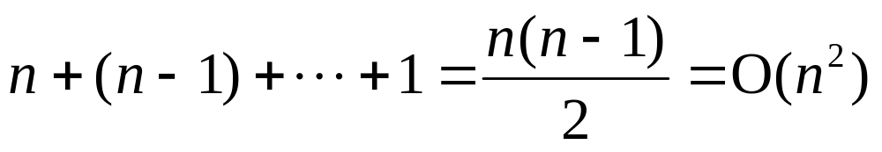
Worst case : O(n²)
In each round, the number used to split is either the smallest or the largest.

Slide 44
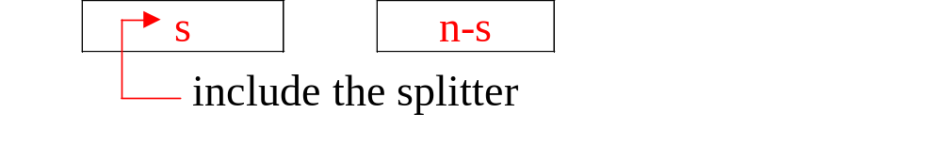
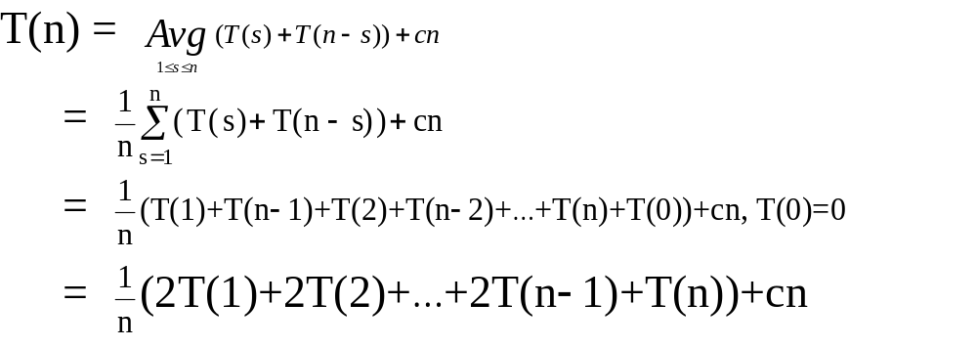
Average case: O(n log n)
T(1) T(n-1)

Slide 45
T(1) T(n-1)
T(2) T(n-2)
T(3) T(n-3)
. .
T(n-2) T(2) .
T(n -1) T(1)
T(n) T(0)

Slide 46
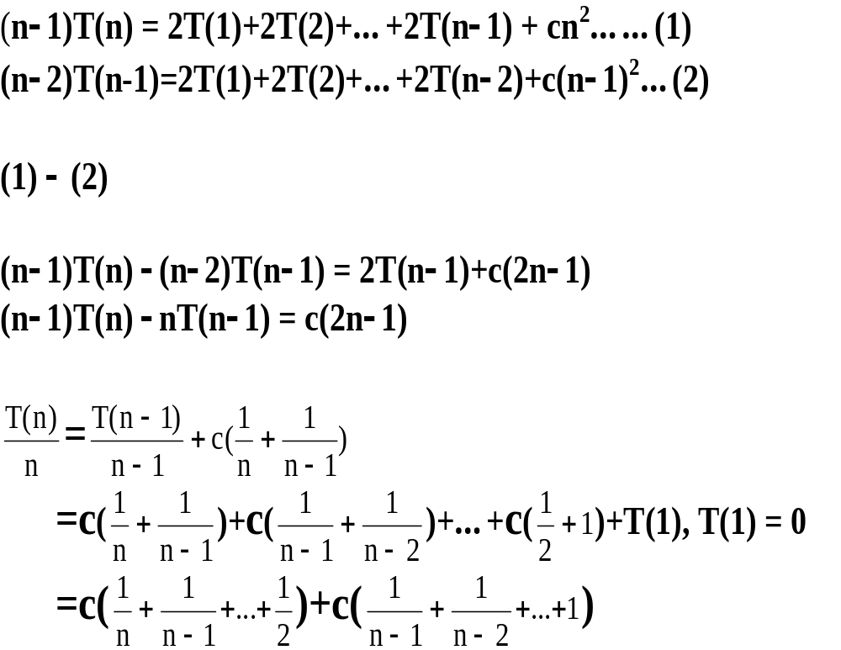

Slide 47
<= 2log(n)+ constant
Thus
T(n) <= n log(n)

Slide 48
Example of insertion sort
8
2
4
9
3
6
2
8
4
9
3
6
2
4
8
9
3
6
2
4
8
9
3
6
2
3
4
8
9
6
2
3
4
6
8
9
done

Slide 49
Worst/ best/average cases
Worst case is the longest running time for any input of size n
O-notation represents upper bound I.e. an upper bound for worst case.
Best case is time taken for some input data set that results in best possible performance.You cannot do better. This is lower bound.
Average case is the average performance

Slide 50
Asymptotic Notation
Goal: to simplify analysis by getting rid of unneeded information (like “rounding” 1,000,001≈1,000,000)
We want to say in a formal way 3n² ≈ n²

Slide 51
The “Big-Oh” Notation:
given functions f(n) and g(n), we say that f(n) is O(g(n) ) if and only if there are positive constants c and n₀ such that f(n)≤ c g(n) for
  n ≥ n₀

Slide 52
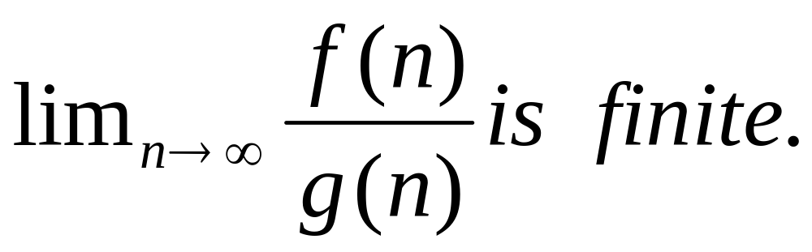
f(n) is O(g(n) if

Slide 53
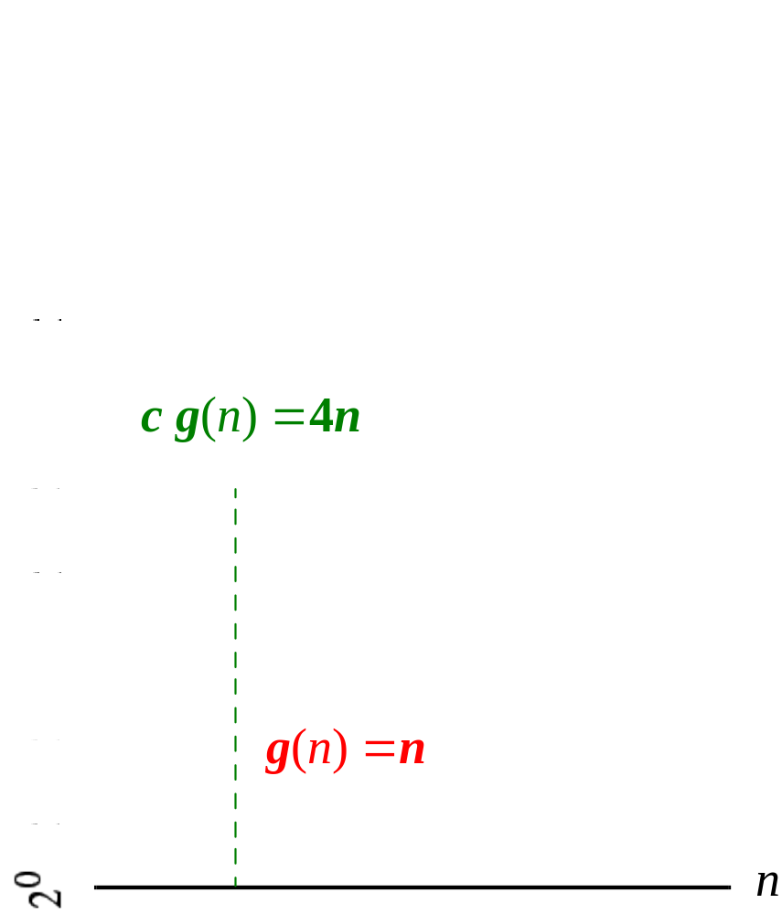

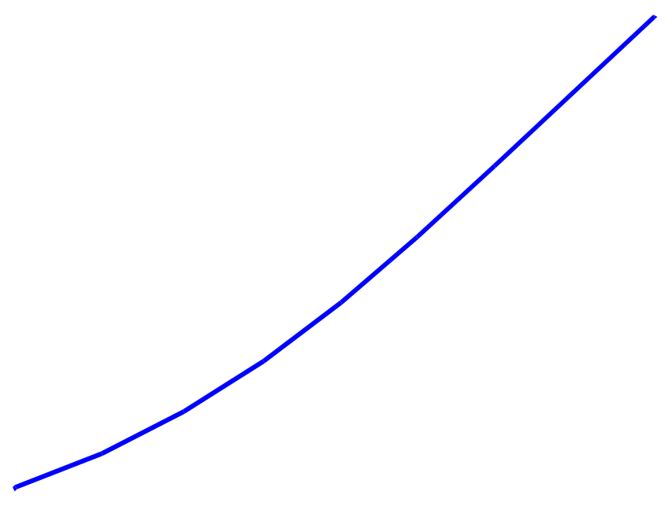
Example
For functions f(n) and g(n) (to the right) there are positive constants c and n₀ such that:
f(n) ≤ c g(n)
for n ≥ n₀
conclusion:
2n+6 is O(n).

Slide 54
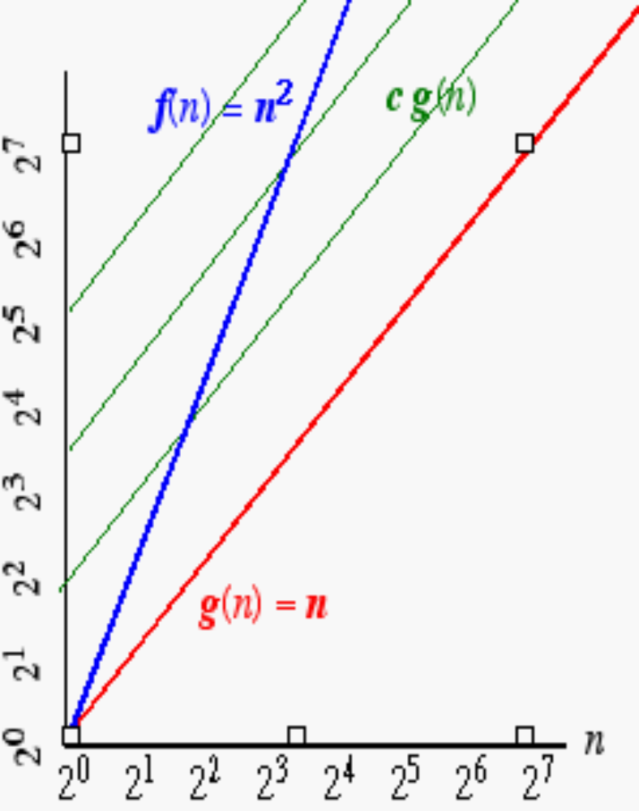
Another Example
On the other hand…
n² is not O(n) because there is no c and n₀ such that: n² ≤ c n for n ≥ n₀
(As the graph to the right illustrates, no matter how large a c is chosen there is an n big enough that
N² > c n ) .

Slide 55
Asymptotic Notation (cont.)
Note: Even though it is correct to say “7n - 3 is O(n³)”, a better statement is “7n - 3 is O(n)”, that is, one should make the approximation as tight as possible
Simple Rule: Drop lower order terms and constant factors
  7n-3 is O(n)
  8n²log n + 5n² + n is O(n²log n)

Slide 56
Asymptotic Notation (terminology)
Special classes of algorithms:
constant O(1)
  logarithmic: O(log n)
  linear: O(n)
  quadratic: O(n²)
  polynomial: O(n^{k}), k ≥ 1
  exponential: O(a^{n}), a > 1

Slide 57
EXAMPLE
Consider 1/3 n² – 5n
The dominating term is n²
Therefore it should be of O(n²)
Given a positive constant c , a positive integer n₀ to be found such that
1/3 n² - 5 n ≤ c n²

Slide 58
Dividing the inequality throughout by n²
1/3 - 5/n ≤ c
Therefore if n₀ ≥ 1 , choosing c ≥ 1/3 the inequality will never be violated
Hence the expression is indeed of O(n²)

Slide 59
Polynomial of degree k is O( n^{k})
T(n) = a_{k} n^{k} + a_{k-1} n^{k-1} +……..a₀ is O( n^{k})
T(n) <= |a_{k}| n^{k} +| a_{k-1}| n^{k-1} +…….|a₀|
<= n^{k}(|a_{k}| n⁰ +| a_{k-1}| n⁻¹ +…….|a₀|n^{-k})
<= n^{k}(|a_{k}| n⁰ +| a_{k-1}| n⁻¹ +…….|a₀|n^{-k}) for n >1
Since n >1 n ^{I-k} <1 for I 0 <= I <= k
Therefore
T(n) <= n^{k} ( |a₀| + |a₁ | + …. |a_{k} |)
let c = ( |a₀| + |a₁ | + …. |a_{k} |)
And f(n) = n^{k}
T(n) <= c f(n) for n >1
Thus T(n) = O( n^{k})

Slide 60
“Relatives” of the Big-Oh
Ω (f(n)): Big Omega--asymptotic lower bound
  Θ (f(n)): Big Theta--asymptotic tight bound

Slide 61
Little o
Informally, saying some equation f(n) = o(g(n)) means f(n) becomes insignificant relative to g(n) as n approaches infinity. The notation is read,
"f of n is little oh of g of n".
Formal Definition: f(n) = o(g(n)) means
for all c > 0 there exists some n₀ > 0 such that
0 ≤ f(n) < cg(n) for all n ≥ n₀

Slide 62
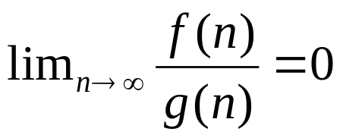
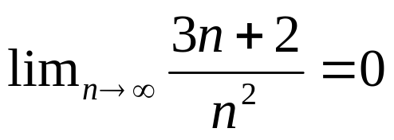
3n+2 =o(n² )
since
3n+2 ≠ o(n) while 3n+2 =O(n)

Slide 63
Therefore, Big-O can be read as
"f ∈ O(g) means that f's asymptotic growth is no faster than g's",
whereas "f ∈ o(g) means that
f's asymptotic growth is strictly slower than g's".

Slide 64
f ∈ O(g) says, essentially
For at least one choice of a constant c > 0, you can find a constant n_{o} such that the inequality 0 <= f(x) <= c g(x) holds for all x > n_{o}
Note that O(g) is the set of all functions for which this condition holds.
f ∈ o(g) says, essentially
For every choice of a constant c > 0, you can find a constant n_{o} such that the inequality 0 <= f(x) <cg(x) holds for all x > n_{o}
Once again, note that o(g) is a set.

Slide 65
More specifically, if
the value of g(x) is a constant multiple of the value of f(x), then f ∈ O(g) is true.
This is why you can drop constants when working with big-O notation.
However, for f ∈ o(g) to be true, then g must include a higher power of x in its formula, and so the relative separation between f(x) and g(x) must actually get larger as x gets larger.

Slide 66
Note that if f ∈ o(g), this implies f ∈ O(g). e.g. x^2 ∈ o(x^3)

Slide 67
Asymptotic Analysis of The Running Time
Use the Big-Oh notation to express the number of primitive operations executed as a function of the input size.
Comparing the asymptotic running time
  -an algorithm that runs in O(n) time is better than one that runs in O(n²) time
  -similarly, O(log n) is better than O(n)
  -hierarchy of functions:
  log n << n << n² << n³ << 2^{n}

Slide 68
Caution! Beware of very large constant factors.
An algorithm running in time 1,000,000 n is still
O(n) but might be less efficient on your data set
than one running in time 2n², which is O(n²)

Slide 69
Properties of the O notation
Constant factors may be ignored
  ∀ k > 0, kf is O( f)

Slide 70
Properties of the O notation
Constant factors may be ignored
  ∀ k > 0, kf is O( f)
Higher powers grow faster
  n^{r} is O( n^{s}) if 0 ≤ r ≤ s

Slide 71
Properties of the O notation
Constant factors may be ignored
  ∀ k > 0, kf is O( f)
Higher powers grow faster
  n^{r} is O( n^{s}) if 0 ≤ r ≤ s
Fastest growing term dominates a sum
  If f is O(g), then f + g is O(g)
  eg an⁴ + bn³ is O(n⁴ )

Slide 72
Properties of the O notation
Constant factors may be ignored
  ∀ k > 0, kf is O( f)
Higher powers grow faster
  n^{r} is O( n^{s}) if 0 ≤ r ≤ s
. Fastest growing term dominates a sum
  If f is O(g), then f + g is O(g)
  eg an⁴ + bn³ is O(n⁴ )
. Polynomial’s growth rate is determined by leading term
  If f is a polynomial of degree d,
  then f is O(n^{d})

Slide 73
Properties of the O notation
f is O(g) is transitive
  If f is O(g) and g is O(h) then f is O(h)

Slide 74
Properties of the O notation
Product of upper bounds is upper bound for the product
  If f is O(g) and h is O(r) then fh is O(gr)

Slide 75
Properties of the O notation
f is O(g) is transitive
  If f is O(g) and g is O(h) then f is O(h)
Product of upper bounds is upper bound for the product
  If f is O(g) and h is O(r) then fh is O(gr)
Exponential functions grow faster than powers
  n^{k} is O( b^{n} ) ∀ b > 1 and k ≥ 0
  eg n²⁰ is O( 1.05^{n})

Slide 76
Properties of the O notation
f is O(g) is transitive
  If f is O(g) and g is O(h) then f is O(h)
Product of upper bounds is upper bound for the product
  If f is O(g) and h is O(r) then fh is O(gr)
Exponential functions grow faster than powers
  n^{k} is O( b^{n} ) ∀ b > 1 and k ≥ 0
  eg n²⁰ is O( 1.05^{n})
Logarithms grow more slowly than powers
  log_{b}n is O( n^{k}) ∀ b > 1 and k > 0
  eg log₂n is O( n^{0.5})
  Thus {log₂(n)}² is O(n^{k}) for any k > 0

Slide 77
Properties of the O notation
f is O(g) is transitive
  If f is O(g) and g is O(h) then f is O(h)
Product of upper bounds is upper bound for the product
  If f is O(g) and h is O(r) then fh is O(gr)
Exponential functions grow faster than powers
  n^{k} is O( b^{n} ) ∀ b > 1 and k ≥ 0
  eg n²⁰ is O( 1.05^{n})
Logarithms grow more slowly than powers
  log_{b}n is O( n^{k}) ∀ b > 1 and k > 0
  eg log₂n is O( n^{0.5})
Important!

Slide 78
Properties of the O notation
All logarithms grow at the same rate
  log_{b}n is O(log_{d}n) ∀ b, d > 1

Slide 79
Properties of the O notation
All logarithms grow at the same rate
  log_{b}n is O(log_{d}n) ∀ b, d > 1
Sum of first n r^{th} powers grows as the (r+1)^{th} power
  Σ k^{r} is Θ ( n^{r+1} )
  eg Σ i = is Θ ( n² )
n
k=1
n
n(n+1)
k=1
2

Slide 80
Polynomial and Intractable Algorithms
Polynomial Time complexity
  An algorithm is said to be polynomial if it is
  O( n^{d} ) for some integer d
  Polynomial algorithms are said to be efficient
    They solve problems in reasonable times!
Intractable algorithms
  Algorithms for which there is no known polynomial time algorithm
  We will come back to this important class later in the course

Slide 81
Categories of algorithm efficiency
Efficiency Constant | Big O O(1)
Logarithmic | O(log n)
Linear | O(n)
Linear logarithmic | O(n log n)
Quadratic | O(n²)
Polynomial | O(n^{k})
Exponential | O(c^{n})
Factorial | O(n!)

Slide 82

Θ-notation
For function g(n), Θ(g(n)) is given by:
Θ(g(n)) = {f(n): ∃ +ve constants c₁, c₂, and n₀ such that 0 ≤ c₁g(n) ≤ f(n) ≤ c₂g(n),
∀n ≥ n₀ }
Intuitively: Set of all functions that
have the same rate of growth as g(n).
g(n) is an asymptotically tight bound for f(n).

Slide 83

O -notation
For function g(n), O(g(n)) is given by:
O(g(n)) = {f(n): ∃ +ve constants c and n₀ such that 0 ≤ f(n) ≤ cg(n), ∀n ≥ n₀ }
Intuitively: Set of all functions whose rate of growth is the same as or lower than that of g(n).
g(n) is an asymptotic upper bound for f(n).
f(n) = Θ(g(n)) ⇒ f(n) = O(g(n)).
Θ(g(n)) ⊂ O(g(n)).

Slide 84

Ω -notation
For function g(n), Ω(g(n)) is given by:
Ω(g(n)) = {f(n): ∃ +ve constants c and n₀ such that 0 ≤ cg(n) ≤ f(n), ∀n ≥ n₀ }
Intuitively: Set of all functions whose rate of growth is the same as or higher than that of g(n).
g(n) is an asymptotic lower bound for f(n).
f(n) = Θ(g(n)) ⇒ f(n) = Ω(g(n)).
Θ(g(n)) ⊂ Ω(g(n)).

Slide 85
Relations Between Θ, O, Ω

Slide 86
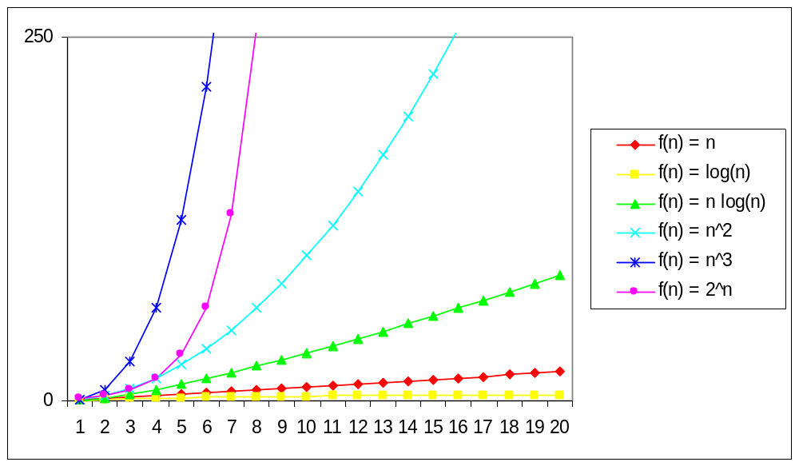
Practical Complexity

Slide 87
Problem size
 | 10 | 10² | 10³ | 10⁴
log₂n | 3.3 | 6.6 | 10 | 13.3
n | 10 | 10² | 10³ | 10⁴
nlog₂n | 0.33x10 | 0.7x10³ | 10⁴ | 1.3x10⁵
n² | 10² | 10⁴ | 10⁶ | 10⁸
2^{n} | 1024 | 1.3x10³ | >10¹⁰⁰ | >10¹⁰⁰
n! | 3x10⁶ | >10¹⁰⁰ | >10¹⁰⁰ | >10¹⁰⁰

Slide 88
Q1 Find functions f and g such that
(i) f is O (g)
(ii) f is not Θ (g)
(iii) f(n) > g(n) for infinitely many n.
Let us take g(n) = ½ for all n
f(n) be a function with values in(0,1) close to 1.
f(n) = sin(n) or
f(n) = 1/n if n is perfect square and 1 otherwise.

Slide 89
Exercise 1
If the complexity of the algorithm DOIT can be expressed as O(n²)
Calculate the complexity of the following program segment:
I = 1
loop ( I < n)
DOIT(…)
I = I* 2
Answer : O(n² log₂n)

Slide 90
Exercise
Reorder the following complexity from smallest to largest:
N log₂(n)
n + n² + n³
2⁴
√n
Answer :
(a) 2⁴
(b) √n
(c) N log₂(n)
(d) n + n² + n³

Slide 91
Find Two non negative functions f(n) and g(n) such that neither f(n) = O(g(n)) nor g(n) is O(f(n))
Let f(n) = 1+ cos (n)
g(n) = 1+ sin(n)
when f(n) = 0, g(n) = 2
And
when g(n) = 0 , f(n) = 2
it is not possible to find a positive constant c such that f(n) <= c g(n) for large n . Because g(n) always comes back to zero when f(n) is 2

Slide 92
Is 2^{n+1} = O(2^{n} )? Is 2 ^{2n} = O( 2 ^{n})?
Is 2^{n+1} = O(2^{n} )? Yes!
For any c >= 2
2^{n+1} <= C(2^{n} ) for all n >= 1
However
Is 2 ^{2n} = O( 2 ^{n})? Not correct.
Lim 2 ^{2n} / ( 2 ^{n} ) is not finite.

Slide 93
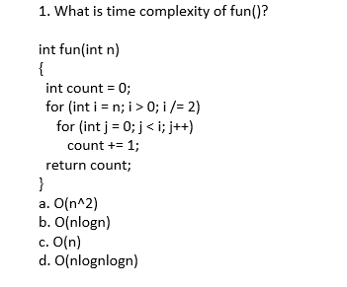

Slide 94
For a input integer n, the innermost statement of fun() is executed following times. n + n/2 + n/4 + ... 1 So time complexity T(n) can be written as T(n) = O(n + n/2 + n/4 + ... 1) = O(n) The value of count is also n + n/2 + n/4 + .. + 1

Slide 95
3. Which of the following is not O(n^2)?
a. (15^10) * n + 12099
b. n^1.98
c. n^3 / (sqrt(n))
d. (2^20) * n

Slide 96
Question 3 Explanation: Ans- c
The order of growth of option c is n2.5 which is higher than n2.

Slide 97

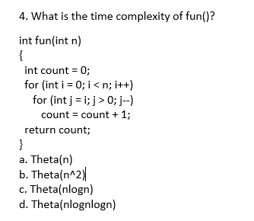
. What is the time complexity of fun()?
a. Theta(n)
b. Theta(n^2)
c. Theta(nlogn)
d. Theta(nlognlogn)

Slide 98
Question 4 Explanation: Ans- b
The time complexity can be calculated by counting number of times the expression "count = count + 1;" is executed. The expression is executed 0 + 1 + 2 + 3 + 4 + .... + (n-1) times. Time complexity = Theta(0 + 1 + 2 + 3 + .. + n-1) = Theta (n*(n-1)/2) = Theta(n2)

